Slide 1

Gas Explosion Detecting and Alerting System using IoT
TEam members :
Varshini L(210701301)
Vaishnavi sri s m(210701299)
Vilashini G(210701308)

Slide 2


Content
Abstract
Existing System
Proposed System
System Architecture
Modules
Result and Discussion
Conclusion and Future Enhancement

Slide 3
ABSTRACT
Hazardous gas leakage occurs in Oil and Gas Industry may leads to various environmental effects . Our project , “Gas explosion detecting and alerting system using IoT” aims to detect the hazardous gas leakage and alert the workers and company management. We have integrated IoT and GSM to send SMS message to the corresponding workers and management. This project uses MQ135 gas leakage detection sensor .When the sensor detects leakage of gas , the Arduino will activate the alarm buzzer to alert the workers and the it is interfaced with GSM module to send alert message to the management of the company.
GAS EXPLOSION DETECTING AND ALERTING SYSTEM USING IOT

Slide 4

EXISTING SYSTEM
GAS EXPLOSION DETECTING AND ALERTING SYSTEM USING IOT
•Existing system provides only alerting system . In existing model the Arduino or other microcontroller is connected with any gas detecting sensor (like MQ135,MQ6) and when the sensor detects the gas leakage the buzzer buzzed and LED glows .
•It only provides the alert to the workers who are nearby the Hazardous gas container .
•It didn’t alert the management of the company .This is the major drawback of the most existing systems.
GAS EXPLOSION DETECTING AND ALERTING SYSTEM USING IOT
4

Slide 5
Proposed system
GAS EXPLOSION DETECTING AND ALERTING SYSTEM USING IOT
§ The MQ135 sensor is connected with Arduino UNO and placed near the gas container(that is., where the hazardous gas is stored.
§Arduino UNO is connected with GSM shield using SIM card to send alert messages.
§Further the Arduino UNO is connected with LED and Buzzer to alarm the worker in that corresponding place.
§When the sensor detects the gas leakage, the LED glows and Buzzer (alarm) alerts the workers and alert message is send to the management quickly through the GSM shield.
GAS EXPLOSION DETECTING AND ALERTING SYSTEM USING IOT
5

Slide 6
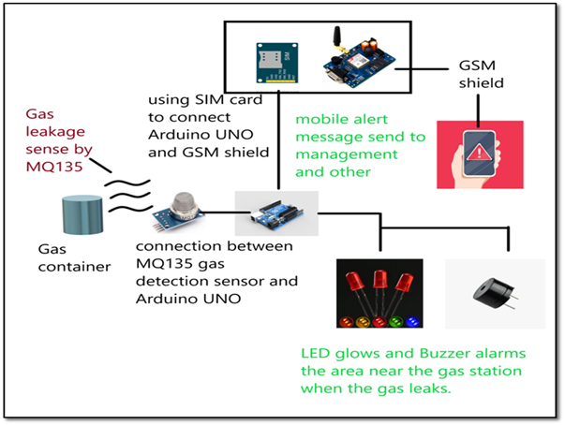
System aRCHITECTURE
GAS EXPLOSION DETECTING AND ALERTING SYSTEM USING IOT
6

Slide 7
MODULES
Modules used in this project :
1.MQ135 Gas Detection Sensor
2.Arduino UNO
3.GSM Module 900A
4.SIM Card
GAS EXPLOSION DETECTING AND ALERTING SYSTEM USING IOT

Slide 8
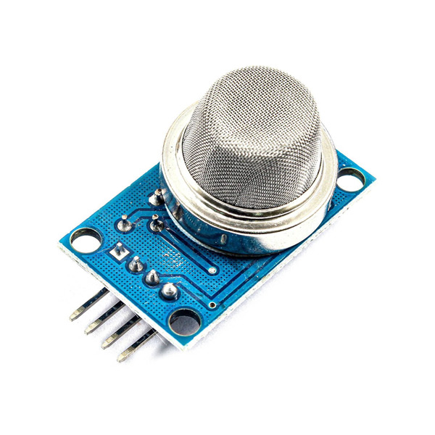



MQ135 Sensor- It is a sensor that detects hazardous gases like methane, Sulphur di oxide, carbon mono oxide and smoke. this sensor module is connected with microcontroller to detect the gas leakage level.

Slide 9
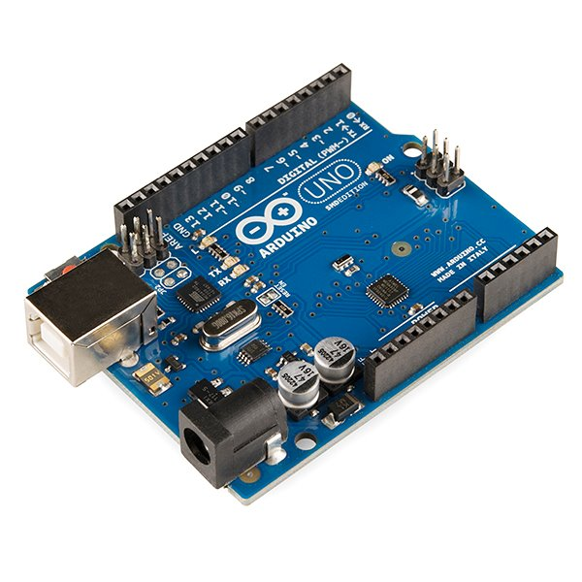
Arduino uno It is a microcontroller that helps to connect the sensor and ide platform to maintain or monitor the data given by the sensor. this is connected with GSM and sensor.

Slide 10
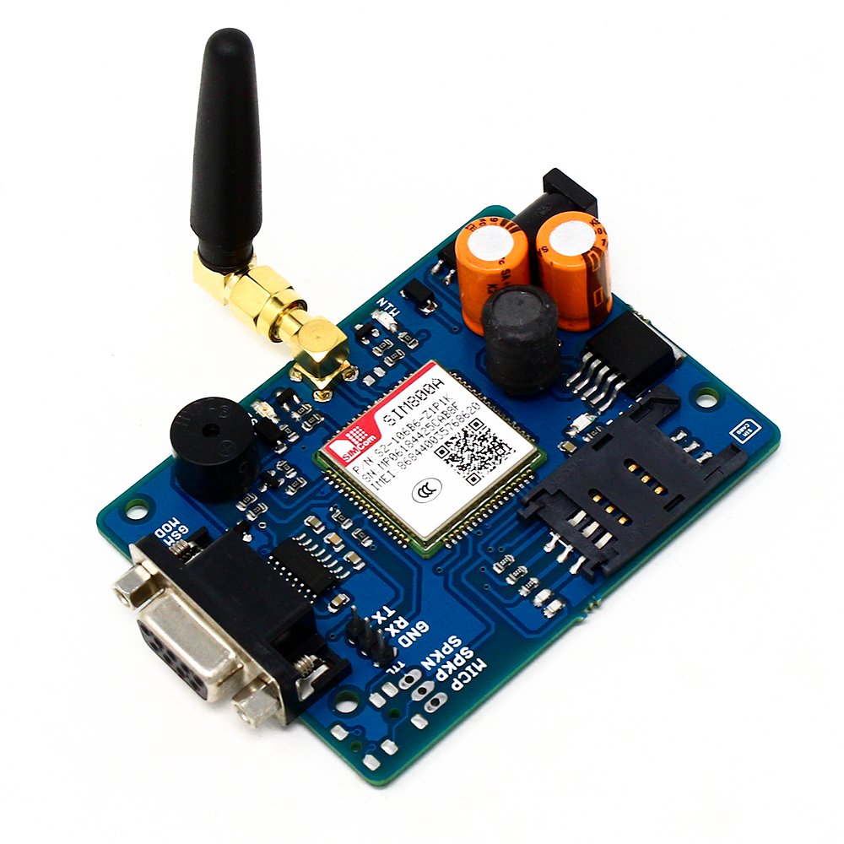
GSM 900A module Gobal system for mobile communication module with 900 hz frequency is used to send message to the connected mobile. It is commonly used in various applications that require cellular communication capabilities.

Slide 11

SIMCard A SIM card, or Subscriber Identity Module card, is a small electronic chip that is used in mobile phones and other cellular-enabled devices to identify and authenticate users on a mobile network. This SIM card is inserted in the GSM Module to send messages to the respected person or a management.

Slide 12
RESULT AND DISCUSSION
The primary results of this project encompass the development and testing of a functional IoT-based gas explosion detection and alerting system. The system successfully utilizes the MQ-135 gas sensor module to detect the presence of combustible gases like methane. The Arduino code effectively interprets sensor readings and compares them to a pre-defined threshold. The GSM shield and SIM card combination facilitates the transmission of SMS alerts to designated phone numbers, ensuring notification of authorities or individuals.
GAS EXPLOSION DETECTING AND ALERTING SYSTEM USING IOT

Slide 13
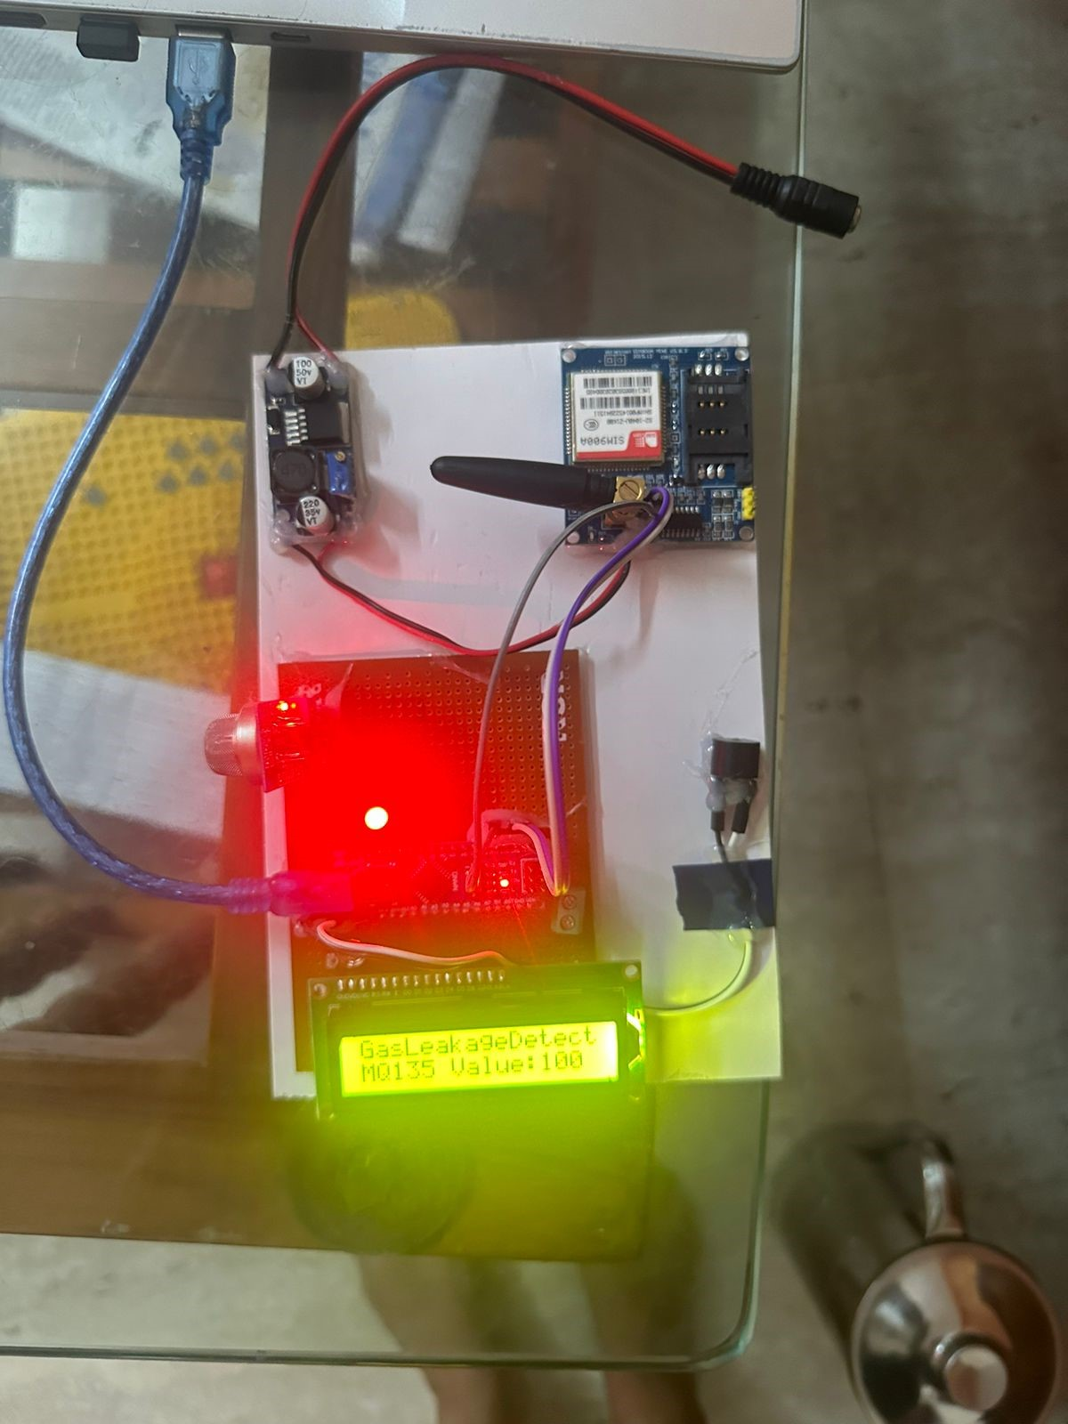
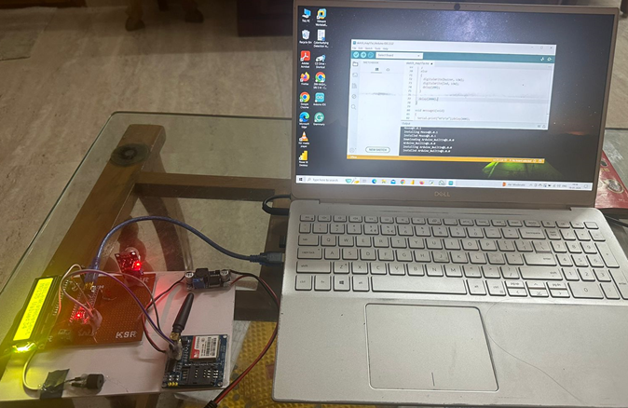
OUTPUT
Connections in the board​
Working Model connected with Arduino IDE​

Slide 14
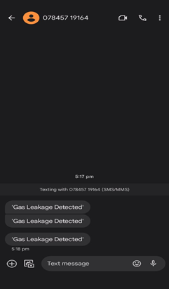
OUTPUT
Alert Message

Slide 15
CONCLUSION AND FUTURE ENHANCEMENT
CONCLUSION:
This project has presented a cost-effective gas explosion detection and alerting system leveraging the power of the Internet of Things (IoT). The system effectively addresses the limitations of traditional gas leak detection methods. The continuous monitoring capabilities of the MQ-135 sensor, coupled with the Arduino's processing power and the GSM shield's communication features, create a robust system for early detection and timely notification. And it is also a multi-faceted alerting system, encompassing a loud buzzer or alarm, a bright LED, and SMS notifications.
GAS EXPLOSION DETECTING AND ALERTING SYSTEM USING IOT

Slide 16
FUTURE ENHANCEMENT
GAS EXPLOSION DETECTING AND ALERTING SYSTEM USING IOT
§ Sensor Integration: Explore the integration of additional sensors for a more comprehensive approach.
§Cloud Connectivity: This would enable remote monitoring of gas concentration levels
§Machine Learning and AI: Implement machine learning algorithms to analyze sensor data over time and learn patterns.
§Self-Diagnostics and Auto-Calibration: Incorporate self-diagnostic features to detect sensor malfunctions
GAS EXPLOSION DETECTING AND ALERTING SYSTEM USING IOT
16

Slide 17



THANK YOU

